Slide 1
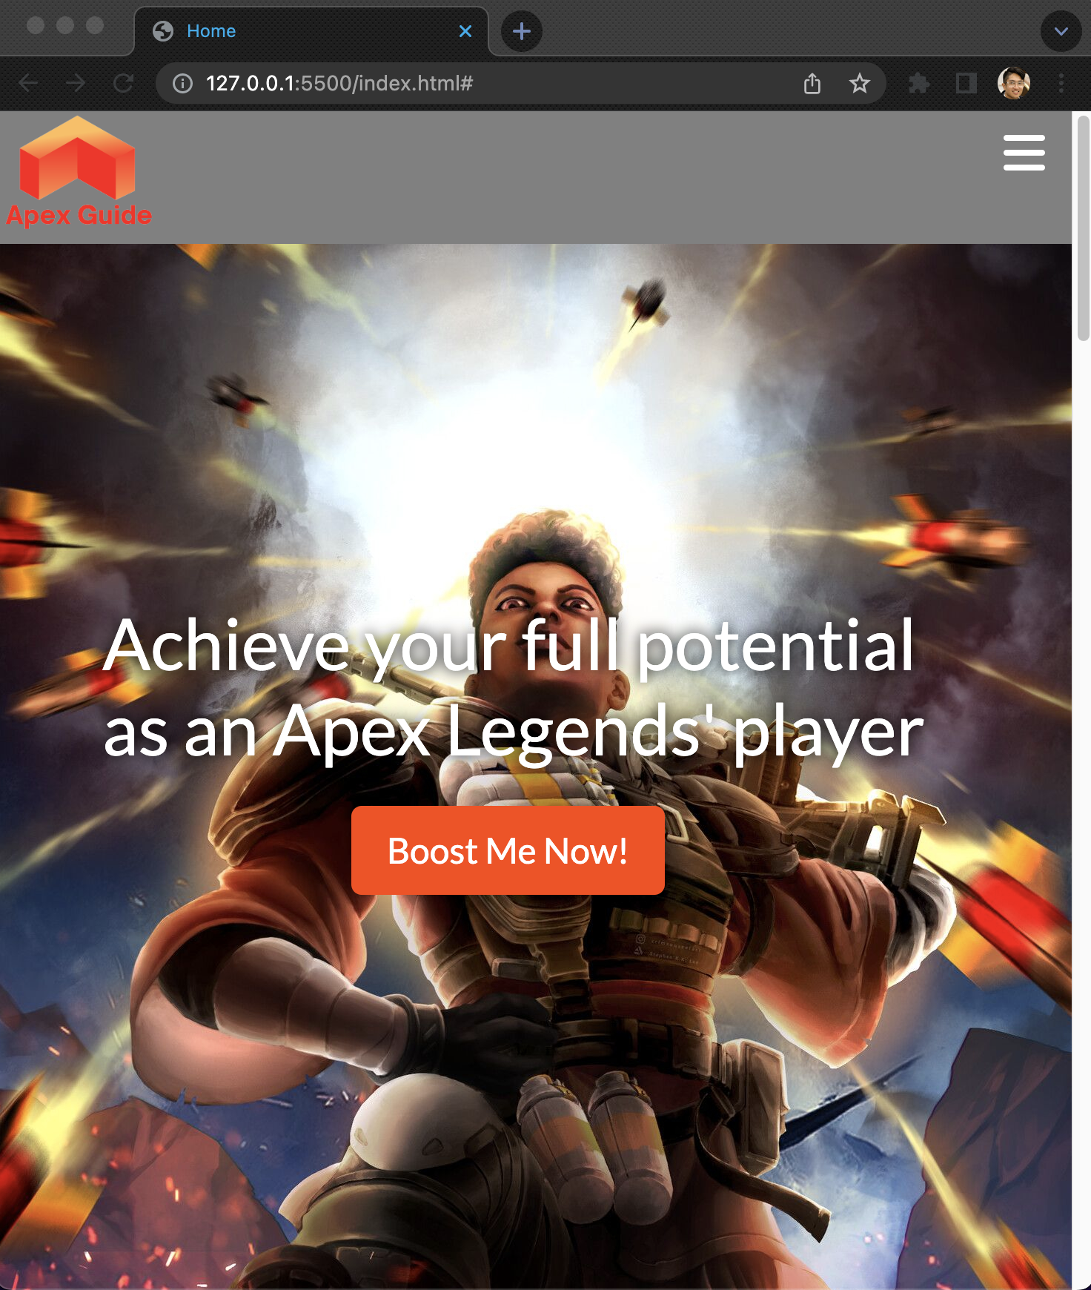
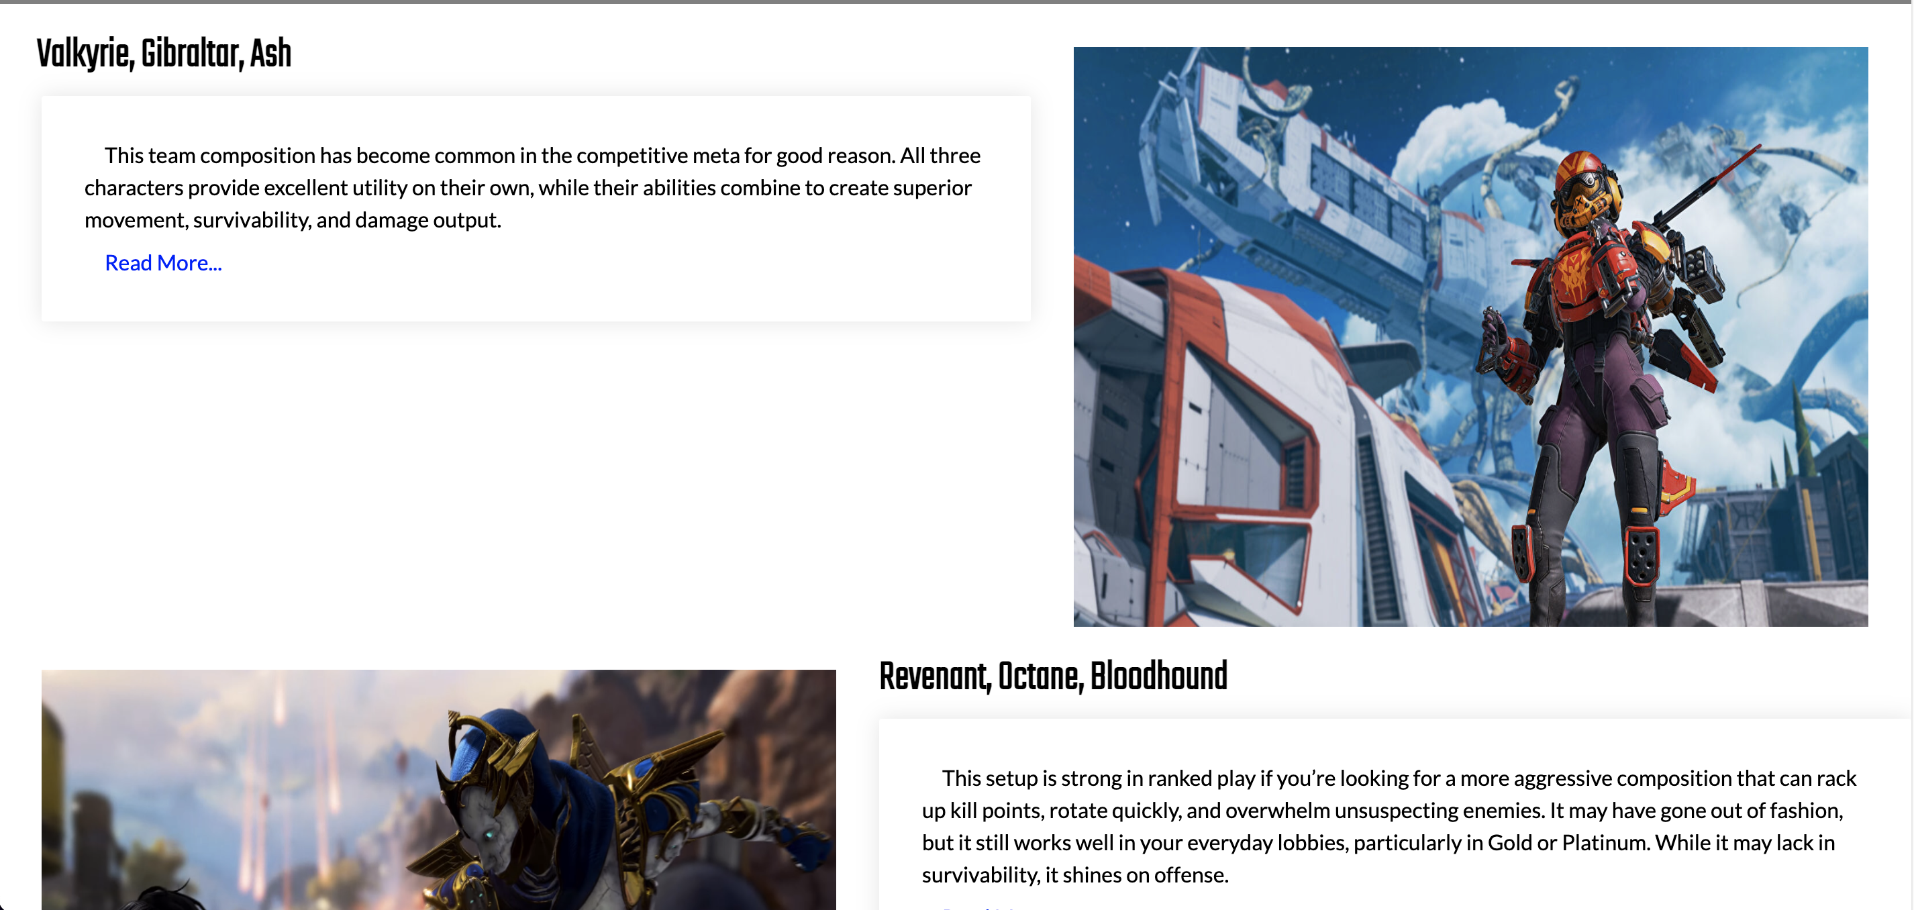
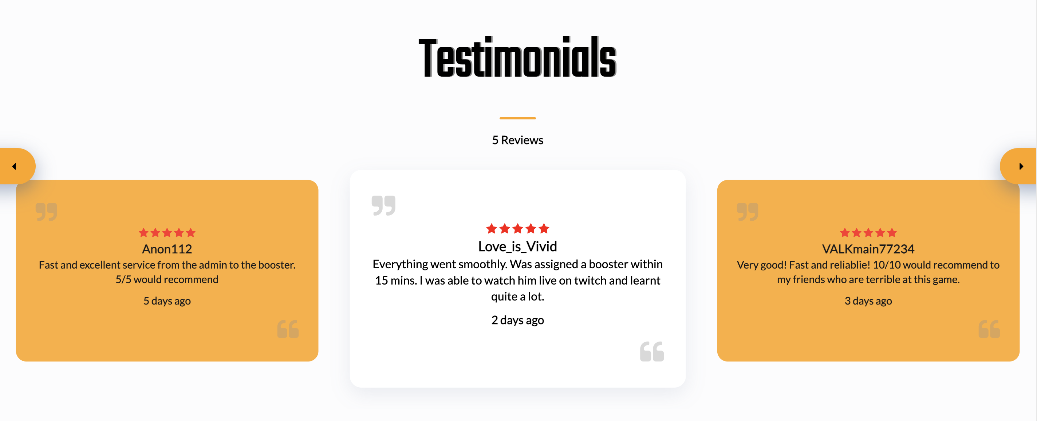
Apex Guide
Website implementation poster by Juan Espares (44317962)
Background Summary
This website is designed for Apex Legends’ players who want to gain more information about the meta of the game and/or purchase a boosting service which increases their individual personal rank in game.
The website was implemented with all pages consisting of the same navbar and footer. This HTML code was duplicated across all webpages except for the signup and login pages which had no footer. The website follows an orange, red and grey color scheme. Important buttons are coloured while secondary buttons are white with an orange border around.
Website Screenshot
Usability Heuristics
There are hover effects for the navbar and footer which highlights what the user is about to click. This demonstrates “Visibility of system status” as feedback is given to the user instantly as they navigate along the website. Another example of this in the homepage is when the user hovers over one of the statistics section’s images. This dynamic effect relays to the user what they are doing to the website (i.e. hovering over a specific statistic). The navbar remaining fixed at the top of the screen allows for “Flexibility and efficiency of use”. It is easily accessed wherever the user navigates to across different webpages and in any webpage itself.
The layout of the website as mentioned above follows either a 3 column where the content is positioned centrally or a 2 column where the content will alternate left and right as the user scrolls down the page. This is to avoid clutter on the webpage and makes it look organized. This follows “Aesthetic and minimalistic design” according to one of Nielsen’s usability heuristics. In addition, the read more / read less feature and the accordion in the Boosting page hides information and only shows them when needed by the user. Furthermore, the color scheme of orange, grey and red is consistent throughout the website. Both of these design features of the website also follow “Aesthetic and minimalistic design”.
The footer contains social media icons which are recognized by the majority of the population. This follows “Match between system and the real world” as these icons are recognizable to the users. The target audience of this website also will recognize the icons used when selecting a platform in the Boosting page.
Lessons Learnt
I was new to javascript and was not accustomed to write functions for event handlers. I had to get my head around arrow functions and function expressions with javascript to really maximise my coding efficiency.
One of the main challenges I faced when implementing the website was styling of the signup/login pages. Prototyping them was easy but using CSS, I had to adjust the positions, width, height, margins and padding in order for it to look the way I wanted to on screen. I learnt to use flexbox to help positioning blocks much easier. However, this was a learning experience for me to utilize div containers properly within HTML.
Future Improvements
Navbar scroll feature – change opacity of navbar when scrolling
Backend support for checkout and dedicated checkout page
Develop more pages with content
Rank icons to be implemented in Boosting page
Users can send their reviews in through another dedicated webpage

